Slide 1
W7, FYP
Wenhui He

Slide 2
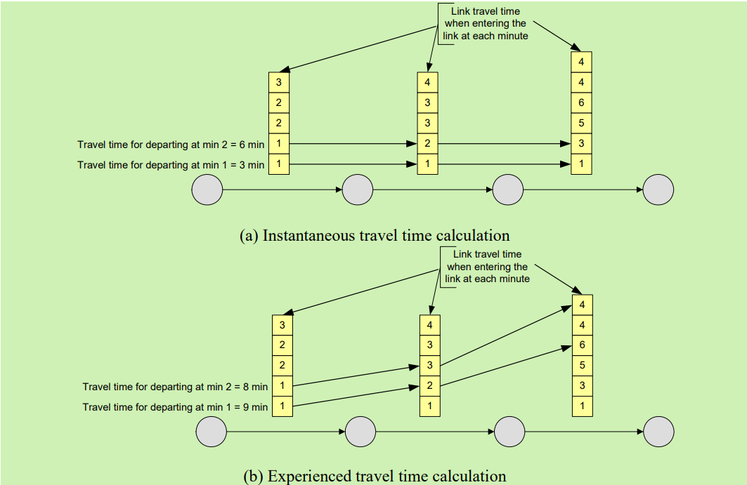
Instantaneous travel time & experienced travel time
instantaneous travel time:
summing up the link travel time corresponding to that same departure time for all links comprising the route
Experienced travel time:
accounts for the time needed for traversing one link, and looks up the downstream link travel time based on the time of entering that downstream link

Slide 3
Process of DTA
Route choices
Iterative step:
Stop when reaching DTA equilibrium point
Network loading
Travel time
Route choices
Adjust route choices towards equilibrium
Find shortest paths
New shortest paths (per OD pair and departure-time interval)

Slide 4
Self-learning algorithms for traffic flow prediction
Parametric
Time series model & KF
High accuracy, low error
But fail to get accuracy result in noisy network (due to stochastic, indeterministic, and non-linear characteristics of traffic flow data)
Non-parametric
DL (extract features, mining high-dimensional data)

Slide 5
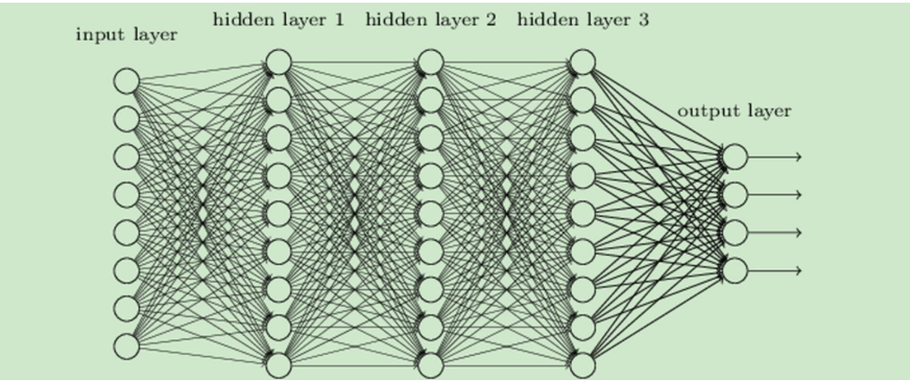
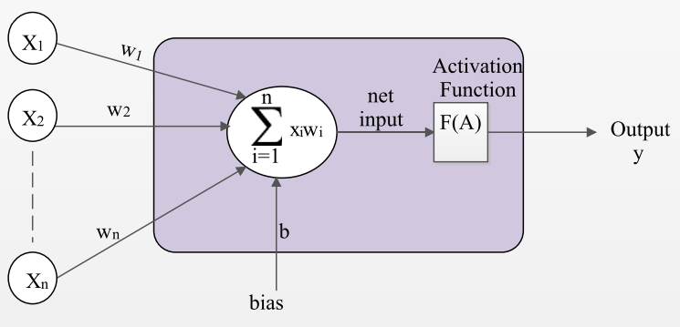
Deep Neural Network (DNN)
Based on perceptron
Forward propagation: get output through linear operations and activation function
Backward propagation: adjust weights with error value

Slide 6
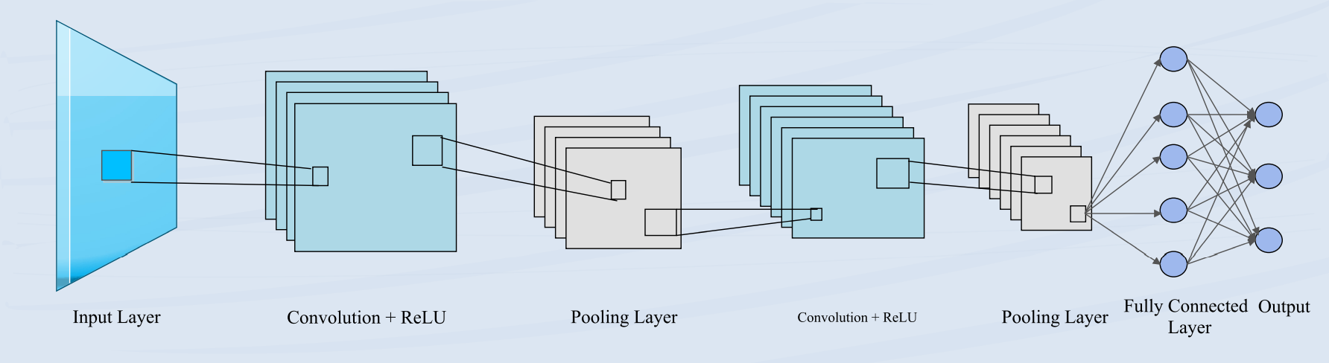
Convolutional Neural Network (CNN)
Backward propagation
image data
Convolution layer:
extract and learn specific image feature
Output higher abstraction of feature representation
Pooling layer:
Reduce the dimensionality of presentation of each feature map to shrink the spatial size of image
vector
weight
Kernels:
Weights
automatically decided
Feature map

